Slide 1
FACE AND EYE DETECTION
Submitted to:-
Dr. Pankaj Shyam Lathar
Head Of Department(IT)
Submitted by:-
Pranesh Kumar Jha
(01220703117)
Prince Sharma
(01320703117)

Slide 2
INTRODUCTION
FACE DETECTION AND EYE DETECTION BY HUMAN:-
Human Brain is trained for face detection and recognition. Face detection and recognition is an easy task for humans.
Experimentally it has been found that even one to three day old babies are able to distinguish between known faces.
So how hard could it be for a computer?

Slide 3
REQUIREMENTS
1) LANGUAGE -> PYTHON
2) LIBRARY -> OpenCV
3) HAARCASCADE FACE XML FILE
4) HAARCASCADE EYE XML FILE

Slide 4
OpenCV
OpenCV is the most popular library for computer vision. Originally written in C/C++, it now provides bindings for Python.
OpenCV uses machine learning algorithms to search for faces within a picture. Because faces are so complicated, there isn’t one simple test that will tell you if it found a face or not. Instead, there are thousands of small patterns and features that must be matched. The algorithms break the task of identifying the face into thousands of smaller, bite-sized tasks, each of which is easy to solve.

Slide 5
INSTALLING OpenCV
First, we need to find the correct setup file for your operating system.
I found that installing OpenCV was the hardest part of the task. If you get strange unexplainable errors, it could be due to library clashes, 32/64 bit differences, and so on. I found it easiest to just use a Linux virtual machine and install OpenCV from scratch.
Once you have completed the installation, you can test whether or not it works by firing up a Python session and typing:
>>> import cv2
>>>

Slide 6
HAAR CASCADES
Robust and very quick
15 times quicker than any technique at the time of release
Classifier training and feature selection using a method called AdaBoost (A long and exhaustive training process)
A degenerate decision tree of classifiers is formed

Slide 7
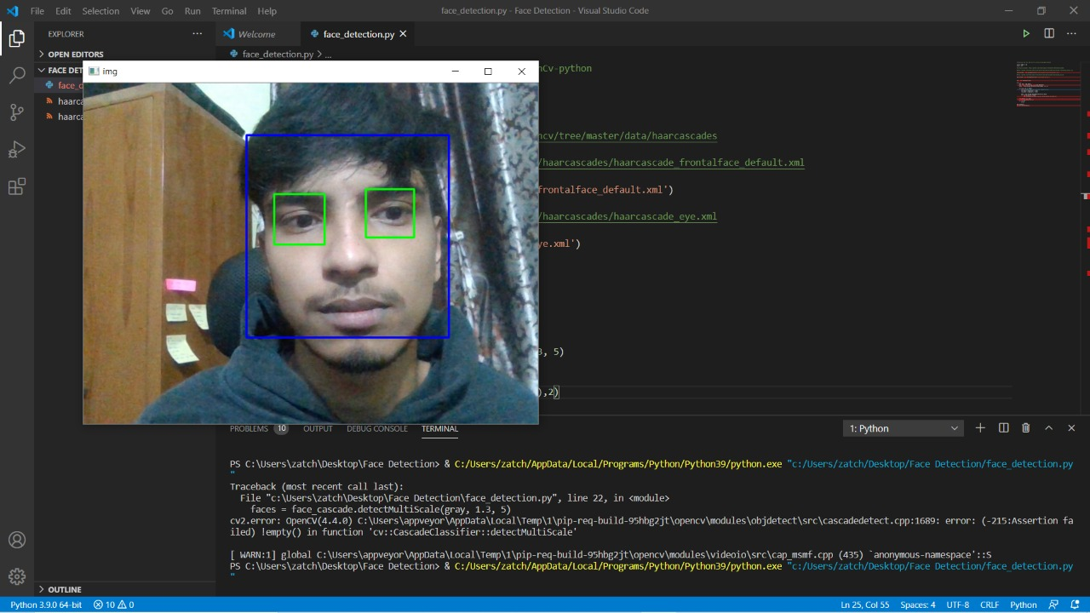
FACE AND EYE DETECTION

Slide 8
APPLICATIONS
Information Security
Access Management
Biometrics
Law Enforcement
Personal Security
Entertainment

Slide 9
REFERENCES
www.realpython.com
www.opencv.org
www.javatpoint.com
www.geeksforgeeks.org

Slide 10
THANKS

